Slide 1
Deep Learning - EX4

Slide 2
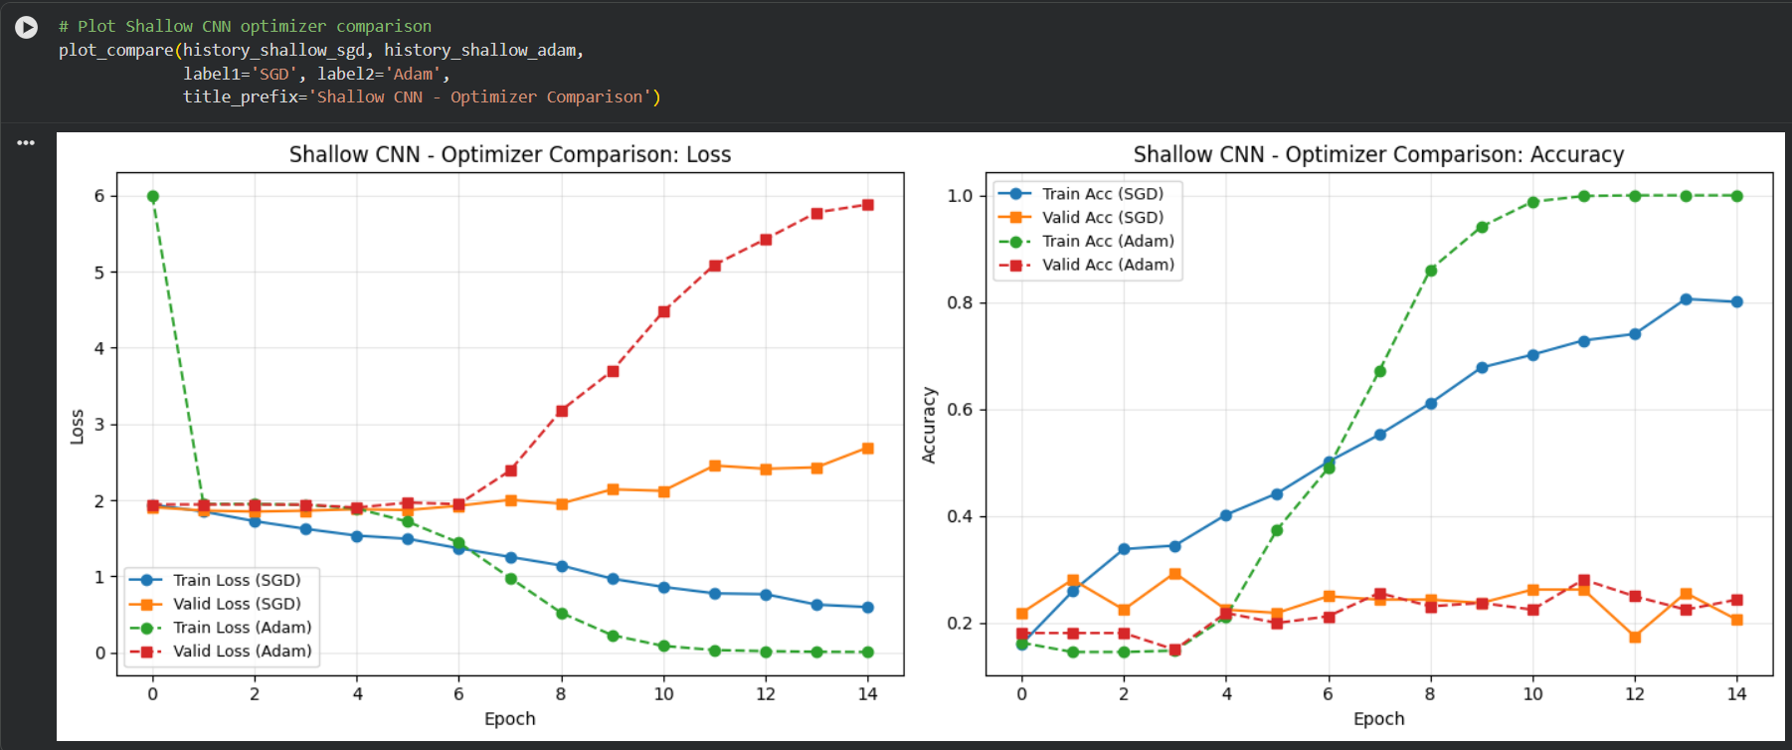
Experiment #1 - Shallow Architecture SGD vs Adam
Training Results Analysis:
Significant overfitting was observed with both optimization algorithm.

Slide 3
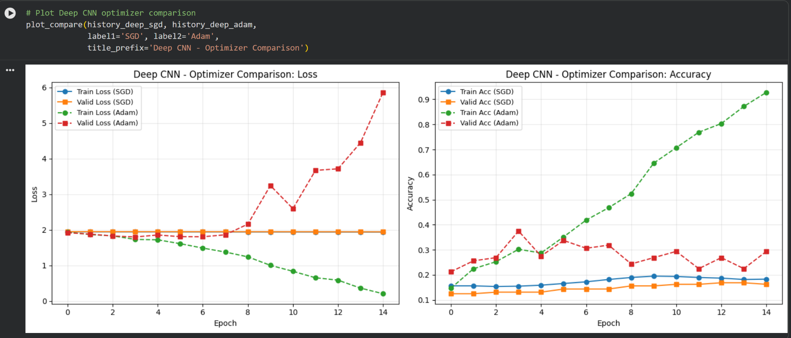
Experiment #2 - Deep Architecture SGD vs Adam
The deep neural network using SGD was unable to learn effectively, as both training and validation losses stayed constant across all epochs. When switching to the Adam optimizer, the training loss decreased and accuracy improved; however, the validation set continued to show high loss and low accuracy, revealing substantial overfitting.

Slide 4
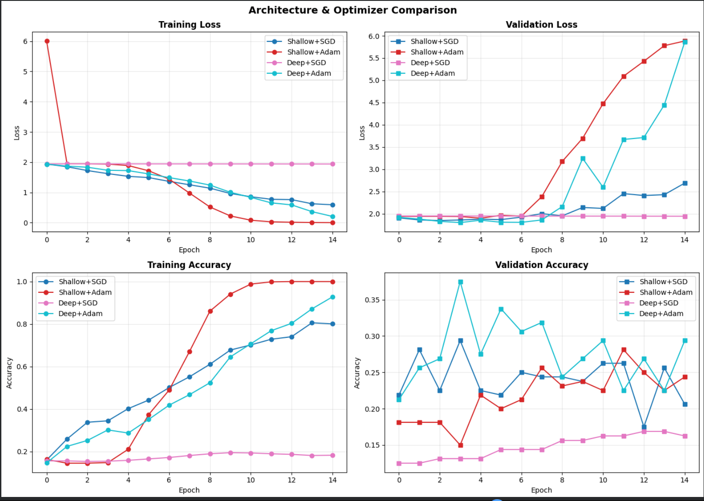

Slide 5
Shallow vs Deep Architecture SGD \ Adam
Train Final Accuracy
Architecture / Optimizer | SGD | Adam
Shallow | 0.8008 | 1
Deep | 0.1832 | 0.9278
Valid Final Accuracy
Architecture / Optimizer | SGD | Adam
Shallow | 0.2062 | 0.2437
Deep | 0.1625 | 0.2938

Slide 6
Learning Rate Experiments
Learning Rate Experiment #1 - Shallow with SGD
Metric / Learning Rate | 0.1 | 0.01 | 0.001 | 0.0001
Final Valid Acc | 0.1688 | 0.2875 | 0.2125 | 0.2250
Learning Rate Experiment #2 - Shallow with Adam
Metric / Learning Rate | 0.1 | 0.01 | 0.001 | 0.0001
Final Valid Acc | 0.15 | 0.1562 | 0.1562 | 0.2687

Slide 7
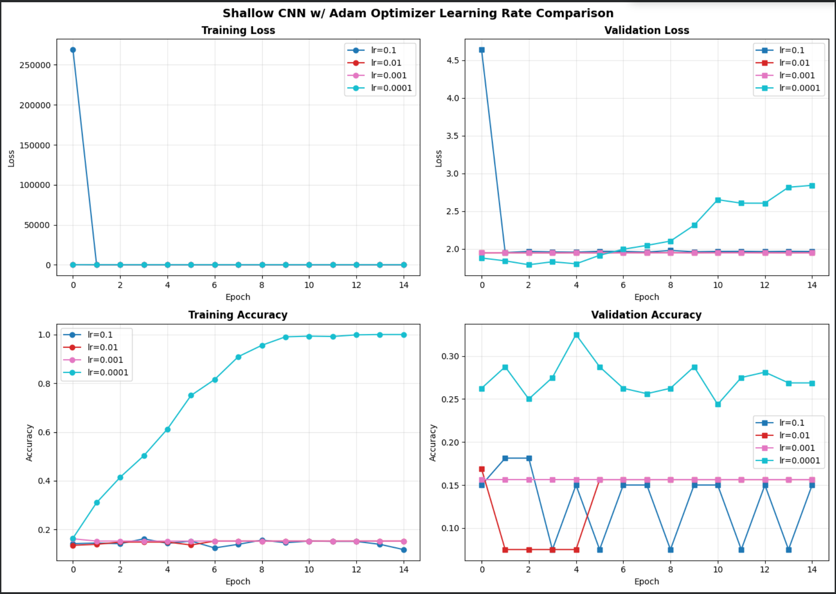
Learning Rate Experiment - Shallow SGD/Adam Results
Out of the tested learning rate values, 0.0001 showed the best results. Showing almost perfect accuracy on the training set and the highest accuracy on the validation set.

Slide 8
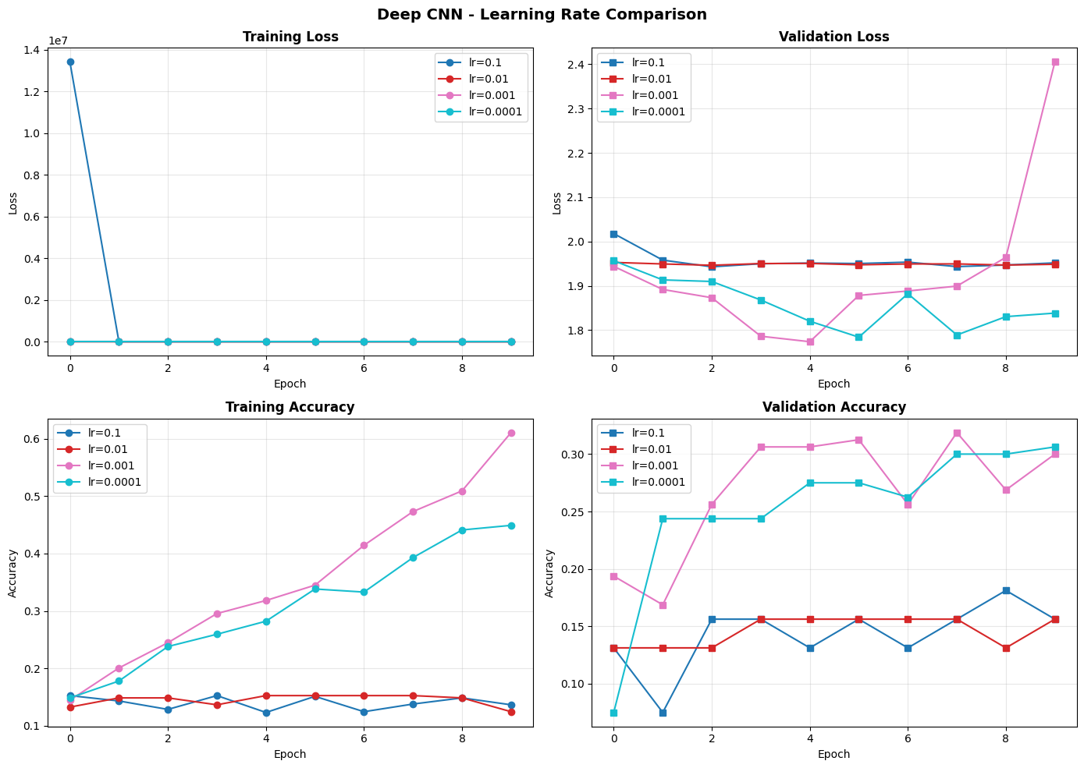
Learning Rate Experiments
Learning Rate Experiment #2 - Deep with Adam
Given that the Deep CNN with SGD optimizer was unable to learn, I will evaluate different learning rates exclusively with the Adam Optimizer
Metric / Learning Rate | 0.1 | 0.01 | 0.001 | 0.0001
Final Valid Acc | 0.1562 | 0.1562 | 0.3 | 0.3063
Results and Summary
Based on the experiments, the optimal configuration is the Deep CNN with Adam optimizer at a learning rate of 0.0001. This setup achieved strong training accuracy while maintaining reasonable performance on the validation set. All subsequent experiments will use this architecture.

Slide 9
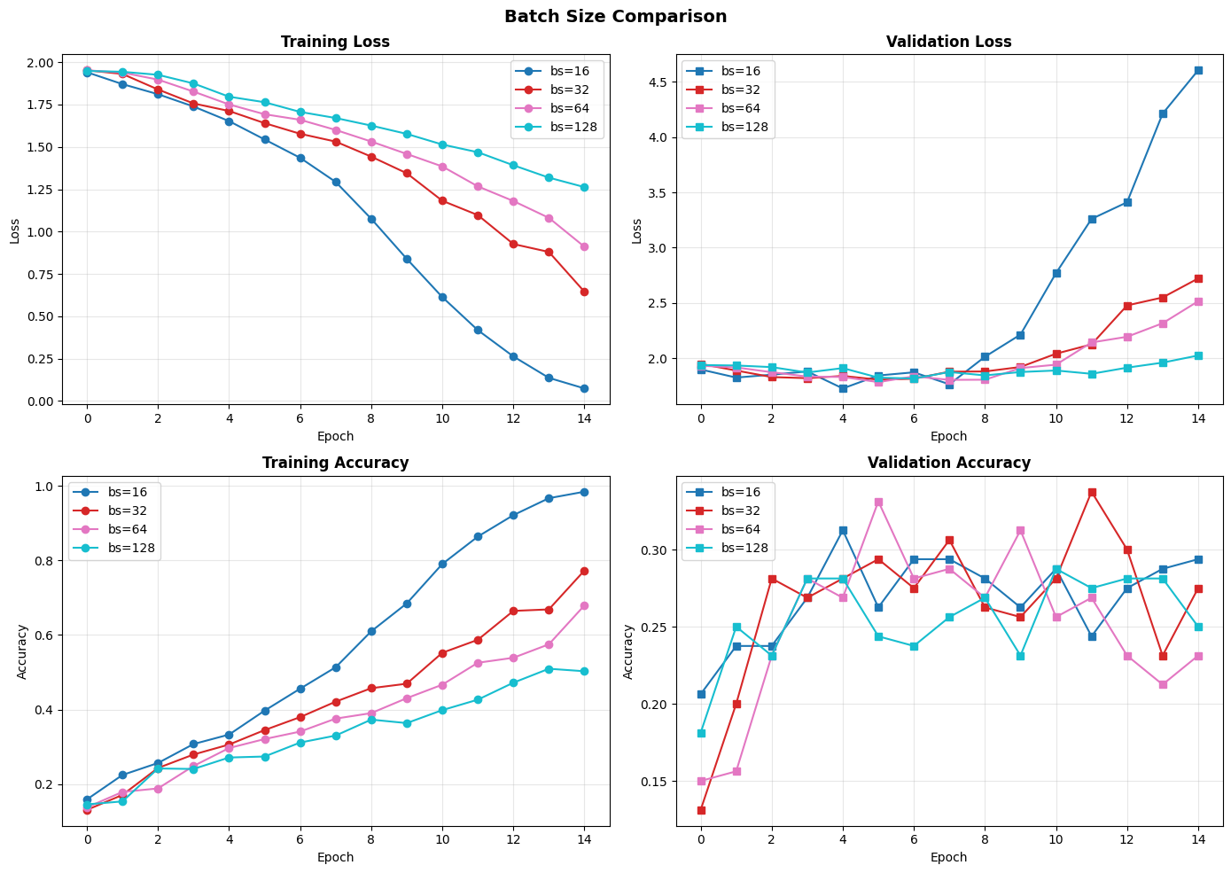
Experiment #3 - Batch Sizes
Test the best model found in the previous steps with different batch sizes [16, 32, 64, 128]
Results: Although batch size 16 produced the best accuracy on training and validation sets, the notably high validation loss indicates risk of overfitting during longer training periods. Batch size 32 offers a better tradeoff, balancing good accuracy with reasonable loss values.

Slide 10
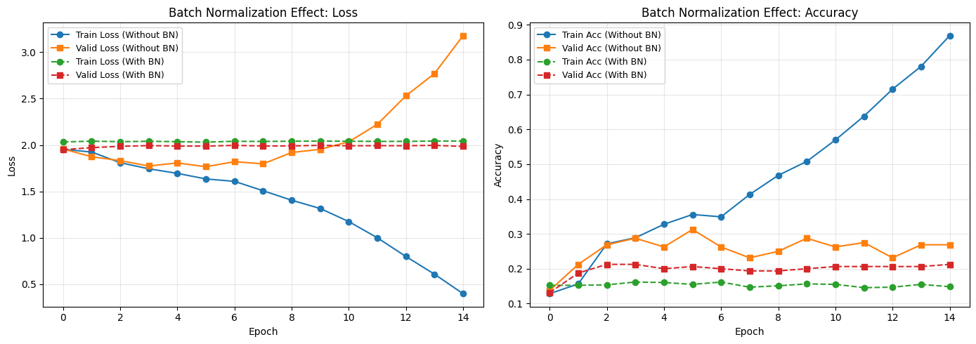
Experiment #4 - Batch Normalization
Batch normalization failed to demonstrate any improvement over training without it.

Slide 11
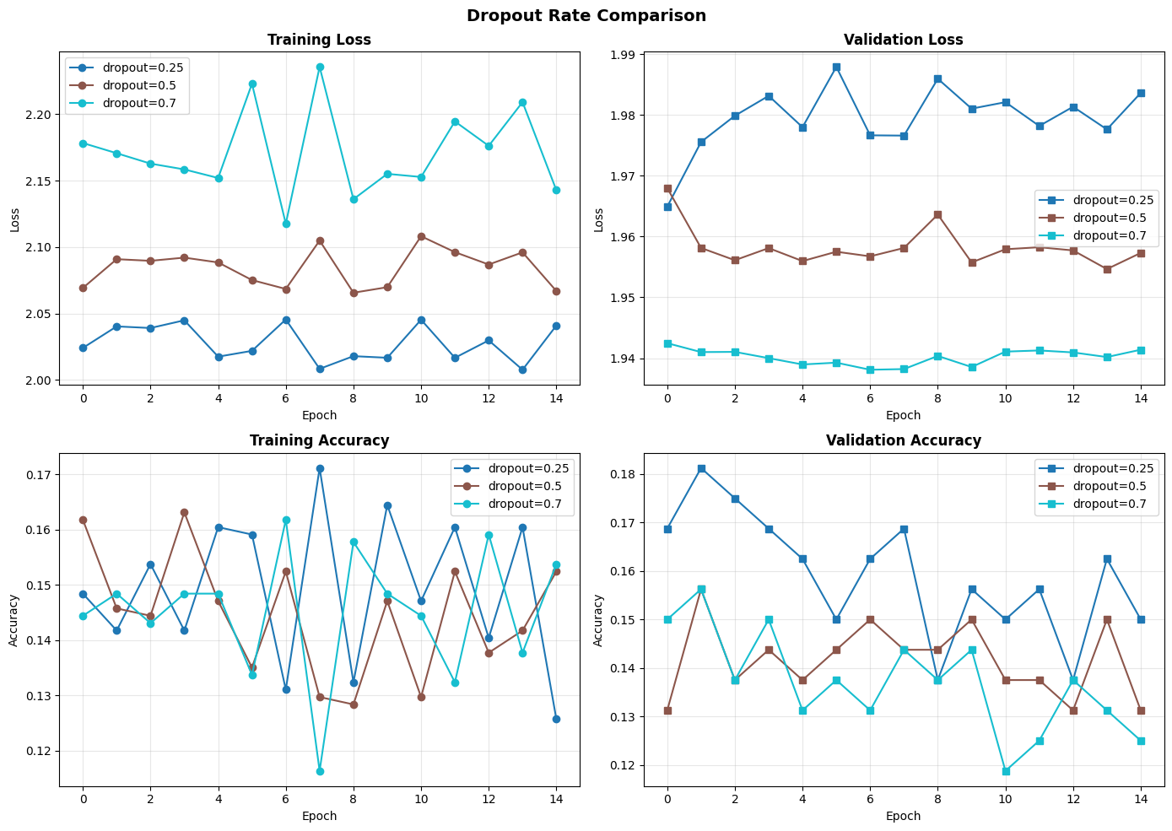
Experiment #5 - Regularization
Drop Out - Test 0.25, 0.5, 0.7 probabilities
Results: Although Neuron Drop Out largely eliminated overfitting, it resulted in extremely low accuracy on both training and test sets - in some cases performing worse than random guessing (1/7 = 0.142). The best model remains Deep CNN, Adam optimizer with 0.0001 lr and 32 batch size.

Slide 12
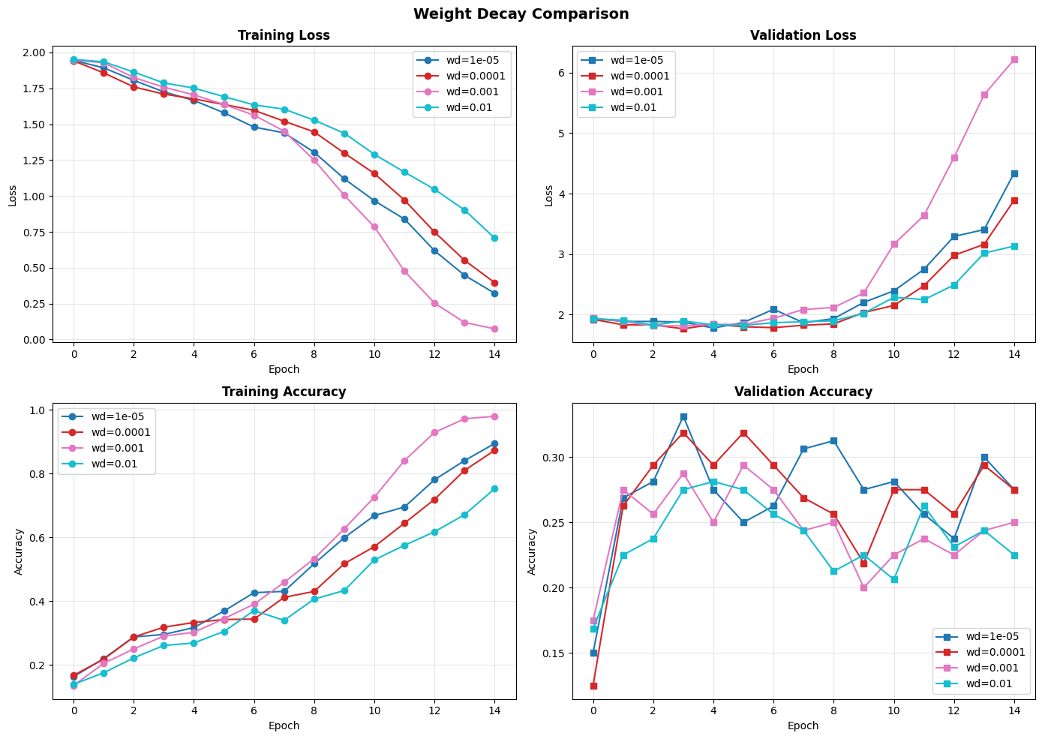
Experiment #5 - Regularization
Weight Decay - Test 0.01, 0.001, 0.0001, 0.00001 probabilities
Results: Weight Decay similarly to Neuron Drop Out largely eliminated overfitting, but it did not show a significant gain in accuracy or narrowing the overfitting gap. The best model remains Deep CNN, Adam optimizer with 0.0001 lr and 32 batch size.

Slide 13
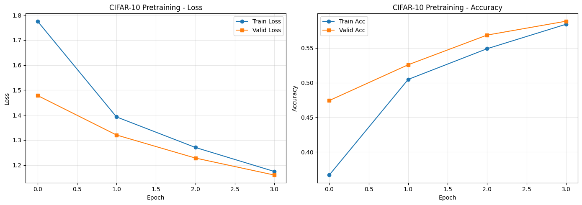
Transfer Learning - Pre-Train on the CIFAR-10 data set
Due to time and resource constraints, trained the best model and hyperparameters found in previous experiments for only 4 epochs on the CIFAR-10 data set. Train Loss - 1.1748 | Train Acc - 0.5842
Valid Loss - 1.1605 | Valid Acc - 0.5886

Slide 14
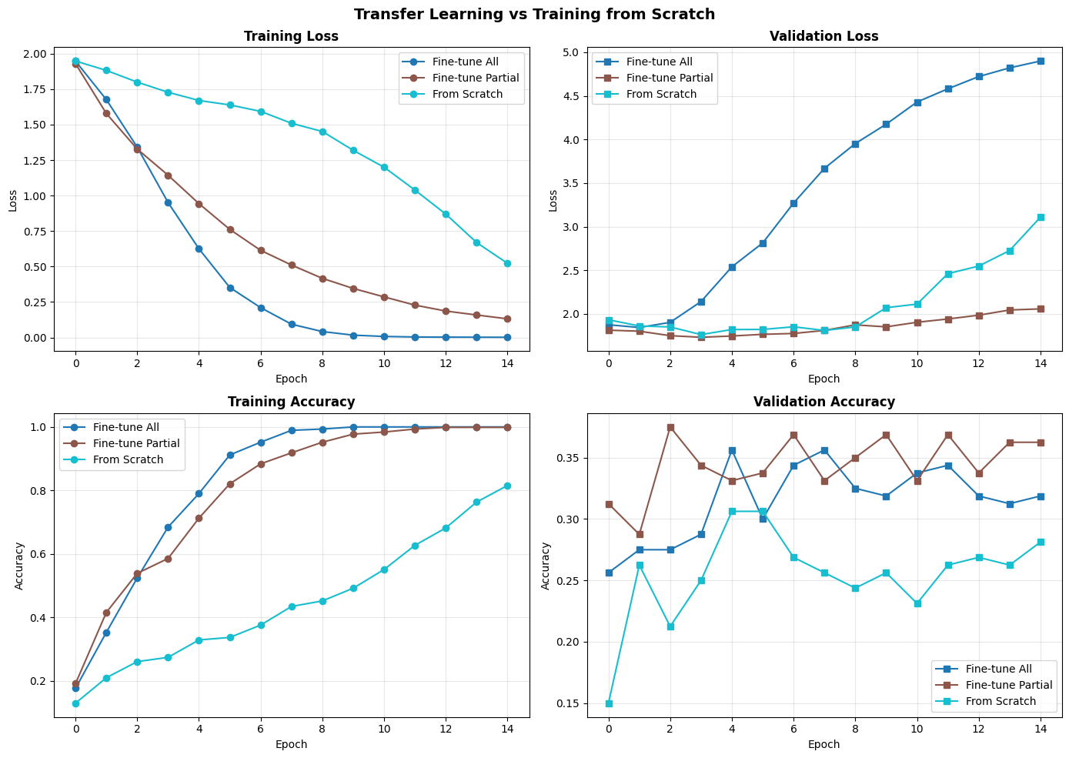
Experiment #6 - Fine tuning
Fine-tune all - Propagate the learning on my data set thru all CNN layers
Fine-tune Partial - Propagate the learning on my data set thru subset of CNN layers
From Scratch - Train CNN on my data set without pre training on CIFAR
Results: Test results show that models pretrained on CIFAR-10 significantly outperformed training from scratch. The configuration that froze the CNN layers and only fine-tuned the fully connected layers (brown) achieved the best performance with 0.3625 validation accuracy and the lowest loss.

